Slide 1

Denial of Service Attacks
Notes:
Chapter 1 listed a number of fundamental security services, including availability.
This service relates to a system being accessible and usable on demand by authorized
users. A denial-of-service attack is an attempt to compromise availability by
hindering or blocking completely the provision of some service. The attack attempts
to exhaust some critical resource associated with the service. An example is flooding
a Web server with so many spurious requests that it is unable to respond to valid
requests from users in a timely manner. This chapter explores denial-of-service
attacks, their definition, the various forms they take, and defenses against them.

Slide 2
Denial-0f-Service (DoS) Attack
The NIST Computer Security Incident Handling Guide defines a DoS attack as:
“an action that prevents or impairs the authorized use of networks, systems, or applications by exhausting resources such as central processing units (CPU), memory, bandwidth, and disk space.”
Notes:
Denial of service is a form of attack on the availability of some service. In the context
of computer and communications security, the focus is generally on network
services that are attacked over their network connection. We distinguish this form
of attack on availability from other attacks, such as the classic acts of god, that
cause damage or destruction of IT infrastructure and consequent loss of service.
The NIST Computer Security Incident Handling Guide [SCAR08] defines
denial-of-service (DoS) attack as follows:
A denial of service (DoS) is an action that prevents or impairs the authorized
use of networks, systems, or applications by exhausting resources such as central
processing units (CPU), memory, bandwidth, and disk space.

Slide 3
Denial-of-Service (DoS)
a form of attack on the availability of some service
categories of resources that could be attacked are:
network bandwidth
relates to the capacity of the network links connecting a server to the Internet
for most organizations this is their connection to their Internet Service Provider (ISP)
system resources
aims to overload or crash the network handling software
application resources
typically involves a number of valid requests, each of which consumes significant resources, thus limiting the ability of the server to respond to requests from other users
Notes:
From this definition, you can see that there are several categories of resources
that could be attacked:
• Network bandwidth
• System resources
• Application resources
Network bandwidth relates to the capacity of the network links connecting a server
to the wider Internet. For most organizations, this is their connection to their Internet
service provider (ISP), as shown in the example network in Figure 7.1 . Usually this
connection will have a lower capacity than the links within and between ISP routers.
This means it is possible for more traffic to arrive at the ISP’s routers over these
higher-capacity links than can be carried over the link to the organization. In this
circumstance, the router must discard some packets, delivering only as many as can
be handled by the link. In normal network operation such high loads might occur
to a popular server experiencing traffic from a large number of legitimate users. A
random portion of these users will experience a degraded or nonexistent service as
a consequence. This is expected behavior for an overloaded TCP/IP network link. In
a DoS attack, the vast majority of traffic directed at the target server is malicious,
generated either directly or indirectly by the attacker. This traffic overwhelms any
legitimate traffic, effectively denying legitimate users access to the server. The GRC.
com (Gibson Research Corporation) Web site contains several reports detailing
DoS attacks on its servers in 2001 and 2002 and its responses to them. These clearly
illustrate the effect of such attacks.
A DoS attack targeting system resources typically aims to overload or crash its
network handling software. Rather than consuming bandwidth with large volumes of
traffic, specific types of packets are sent that consume the limited resources available
on the system. These include temporary buffers used to hold arriving packets, tables of
open connections, and similar memory data structures. The SYN spoofing attack, which
we discuss next, is of this type. It targets the table of TCP connections on the server.
Another form of system resource attack uses packets whose structure triggers
a bug in the system’s network handling software, causing it to crash. This means the
system can no longer communicate over the network until this software is reloaded,
generally by rebooting the target system. This is known as a poison packet . The
classic ping of death and teardrop attacks, directed at older Windows 9x systems,
were of this form. These targeted bugs in the Windows network code that handled
ICMP echo request packets and packet fragmentation, respectively.
An attack on a specific application, such as a Web server, typically involves a
number of valid requests, each of which consumes significant resources. This then
limits the ability of the server to respond to requests from other users. For example,
a Web server might include the ability to make database queries. If a large, costly
query can be constructed, then an attacker could generate a large number of these
that severely load the server. This limits its ability to respond to valid requests from
other users. This type of attack is known as a cyberslam . [KAND05] discusses attacks
of this kind, and suggests some possible countermeasures. Another alternative is to
construct a request that triggers a bug in the server program, causing it to crash.
This means the server is no longer able to respond to requests until it is restarted.
DoS attacks may also be characterized by how many systems are used to direct
traffic at the target system. Originally only one, or a small number of source systems
directly under the attacker’s control, was used. This is all that is required to send the
packets needed for any attack targeting a bug in a server’s network handling code or
some application. Attacks requiring high traffic volumes are more commonly sent
from multiple systems at the same time, using distributed or amplified forms of DoS
attacks. We discuss these later in this chapter.

Slide 4
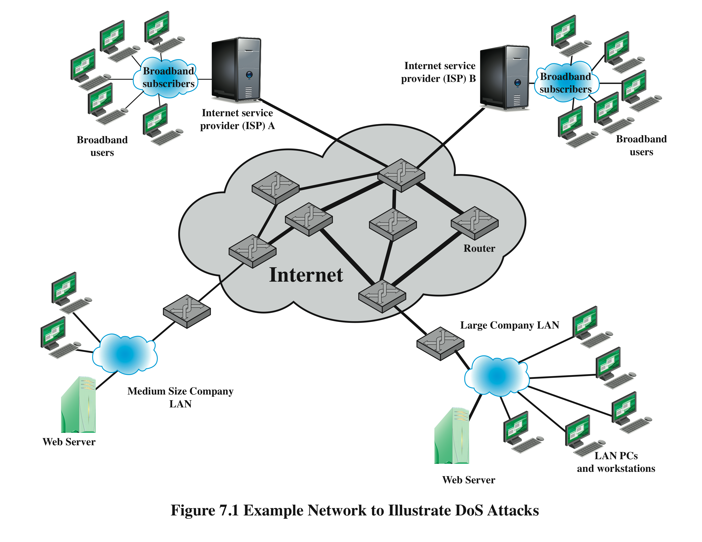
Notes:
Figure 7.1
Example Network to Illustrate DoS Attacks

Slide 5
Classic Denial-of-Service Attacks
flooding ping command
aim of this attack is to overwhelm the capacity of the network connection to the target organization
traffic can be handled by higher capacity links on the path, but packets are discarded as capacity decreases
source of the attack is clearly identified unless a spoofed address is used
network performance is noticeably affected
Notes:
The simplest classical DoS attack is a flooding attack on an organization. The aim
of this attack is to overwhelm the capacity of the network connection to the target
organization. If the attacker has access to a system with a higher-capacity network
connection, then this system can likely generate a higher volume of traffic than the
lower-capacity target connection can handle. For example, in the network shown
in Figure 7.1 , the attacker might use the large company’s Web server to target the
medium-sized company with a lower-capacity network connection. The attack might
be as simple as using a flooding ping command directed at the Web server in the
target company. This traffic can be handled by the higher-capacity links on the path
between them, until the final router in the Internet cloud is reached. At this point
some packets must be discarded, with the remainder consuming most of the capacity
on the link to the medium-sized company. Other valid traffic will have little chance
of surviving discard as the router responds to the resulting congestion on this link.
In this classic ping flood attack, the source of the attack is clearly identified
since its address is used as the source address in the ICMP echo request packets. This
has two disadvantages from the attacker’s perspective. First, the source of the attack
is explicitly identified, increasing the chance that the attacker can be identified and
legal action taken in response. Second, the targeted system will attempt to respond to
the packets being sent. In the case of any ICMP echo request packets received by the
server, it would respond to each with an ICMP echo response packet directed back
to the sender. This effectively reflects the attack back at the source system. Since
the source system has a higher network bandwidth, it is more likely to survive this
reflected attack. However, its network performance will be noticeably affected, again
increasing the chances of the attack being detected and action taken in response. For
both of these reasons the attacker would like to hide the identity of the source system.
This means that any such attack packets need to use a falsified, or spoofed, address.

Slide 6
Source Address Spoofing
use forged source addresses
usually via the raw socket interface on operating systems
makes attacking systems harder to identify
attacker generates large volumes of packets that have the target system as the destination address
congestion would result in the router connected to the final, lower capacity link
requires network engineers to specifically query flow information from their routers
backscatter traffic
advertise routes to unused IP addresses to monitor attack traffic
Notes:
A common characteristic of packets used in many types of DoS attacks is the use
of forged source addresses. This is known as source address spoofing. Given sufficiently
privileged access to the network handling code on a computer system, it
is easy to create packets with a forged source address (and indeed any other attribute
that is desired). This type of access is usually via the raw socket interface on
many operating systems. This interface was provided for custom network testing
and research into network protocols. It is not needed for normal network operation.
However, for reasons of historical compatibility and inertia, this interface has been
maintained in many current operating systems. Having this standard interface available
greatly eases the task of any attacker trying to generate packets with forged
attributes. Otherwise an attacker would most likely need to install a custom device
driver on the source system to obtain this level of access to the network, which is
much more error prone and dependent on operating system version.
Given raw access to the network interface, the attacker now generates large
volumes of packets. These would all have the target system as the destination
address but would use randomly selected, usually different, source addresses for
each packet. Consider the flooding ping example from the previous section. These
custom ICMP echo request packets would flow over the same path from the source
toward the target system. The same congestion would result in the router connected
to the final, lower capacity link. However, the ICMP echo response packets, generated
in response to those packets reaching the target system, would no longer
be reflected back to the source system. Rather they would be scattered across the
Internet to all the various forged source addresses. Some of these addresses might
correspond to real systems. These might respond with some form of error packet,
since they were not expecting to see the response packet received. This only adds to
the flood of traffic directed at the target system. Some of the addresses may not be
used or may not reachable. For these, ICMP destination unreachable packets might
be sent back. Or these packets might simply be discarded. Any response packets
returned only add to the flood of traffic directed at the target system.
Also, the use of packets with forged source addresses means the attacking
system is much harder to identify. The attack packets seem to have originated at
addresses scattered across the Internet. Hence, just inspecting each packet’s header
is not sufficient to identify its source. Rather the flow of packets of some specific
form through the routers along the path from the source to the target system must
be identified. This requires the cooperation of the network engineers managing all
these routers and is a much harder task than simply reading off the source address.
It is not a task that can be automatically requested by the packet recipients. Rather
it usually requires the network engineers to specifically query flow information
from their routers. This is a manual process that takes time and effort to organize.
It is worth considering why such easy forgery of source addresses is allowed on
the Internet. It dates back to the development of TCP/IP, which occurred in a generally
cooperative, trusting environment. TCP/IP simply does not include the ability,
by default, to ensure that the source address in a packet really does correspond with
that of the originating system. It is possible to impose filtering on routers to ensure
this (or at least that source network address is valid). However, this filtering needs
to be imposed as close to the originating system as possible, where the knowledge
of valid source addresses is as accurate as possible. In general, this should occur at
the point where an organization’s network connects to the wider Internet, at the
borders of the ISP’s providing this connection. Despite this being a long-standing
security recommendation to combat problems such as DoS attacks, many ISPs
do not implement such filtering. As a consequence, attacks using spoofed-source
packets continue to occur frequently.
There is a useful side effect of this scattering of response packets to some
origi nal flow of spoofed-source packets. Security researchers, such as those with the
Honeynet Project, have taken blocks of unused IP addresses, advertised routes to
them, and then collected details of any packets sent to these addresses. Since no real
systems use these addresses, no legitimate packets should be directed to them. Any
packets received might simply be corrupted. It is much more likely, though, that
they are the direct or indirect result of network attacks. The ICMP echo response
packets generated in response to a ping flood using randomly spoofed source
addresses is a good example. This is known as backscatter traffic . Monitoring the
type of packets gives valuable information on the type and scale of attacks being
used, as described by [MOOR06], for example. This information is being used to
develop responses to the attacks being seen.

Slide 7
SYN Spoofing
common DoS attack
attacks the ability of a server to respond to future connection requests by overflowing the tables used to manage them
thus legitimate users are denied access to the server
hence an attack on system resources, specifically the network handling code in the operating system
Notes:
Along with the basic flooding attack, the other common classic DoS attack is the
SYN spoofing attack. This attacks the ability of a network server to respond to TCP
connection requests by overflowing the tables used to manage such connections.
This means future connection requests from legitimate users fail, denying them
access to the server. It is thus an attack on system resources, specifically the network
handling code in the operating system.

Slide 8
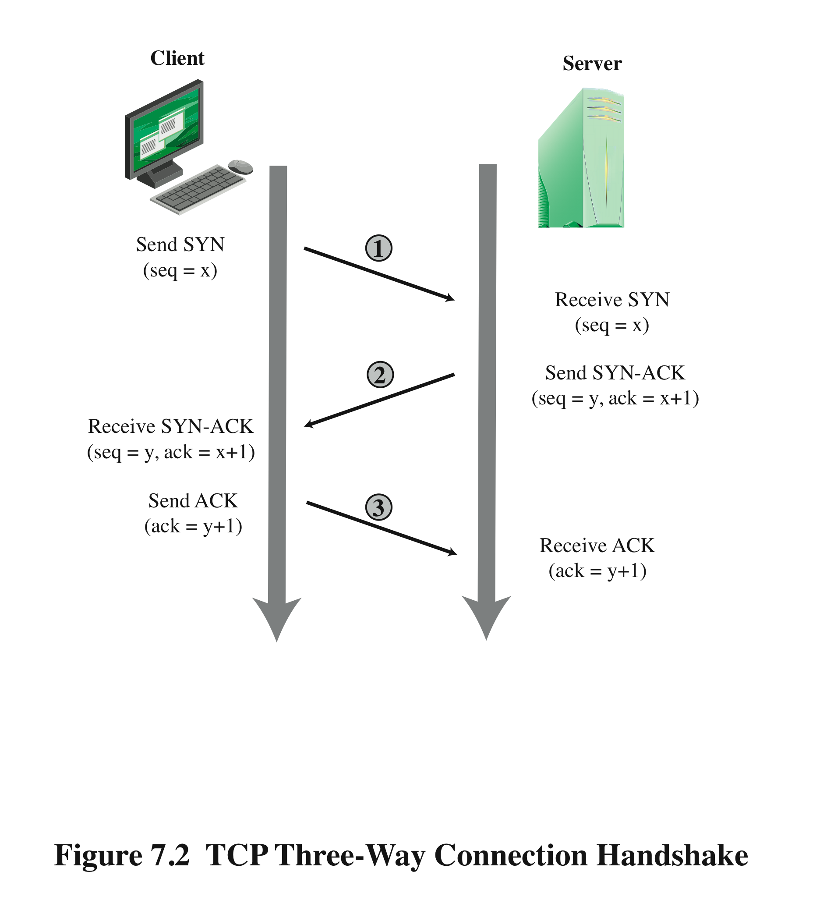
TCP Connection Handshake
Notes:
To understand the operation of these attacks, we need to review the three-way
handshake that TCP uses to establish a connection. This is illustrated in Figure 7.2 .
The client system initiates the request for a TCP connection by sending a SYN packet
to the server. This identifies the client’s address and port number and supplies an
initial sequence number. It may also include a request for other TCP options. The
server records all the details about this request in a table of known TCP connections.
It then responds to the client with a SYN-ACK packet. This includes a sequence
number for the server and increments the client’s sequence number to confirm receipt
of the SYN packet. Once the client receives this, it sends an ACK packet to the server
with an incremented server sequence number and marks the connection as established.
Likewise, when the server receives this ACK packet, it also marks the connection
as established. Either party may then proceed with data transfer. In practice, this
ideal exchange sometimes fails. These packets are transported using IP, which is an
unreliable, though best-effort, network protocol. Any of the packets might be lost in
transit, as a result of congestion, for example. Hence both the client and server keep
track of which packets they have sent and, if no response is received in a reasonable
time, will resend those packets. As a result, TCP is a reliable transport protocol, and
any applications using it need not concern themselves with problems of lost or reordered
packets. This does, however, impose an overhead on the systems in managing
this reliable transfer of packets.

Slide 9
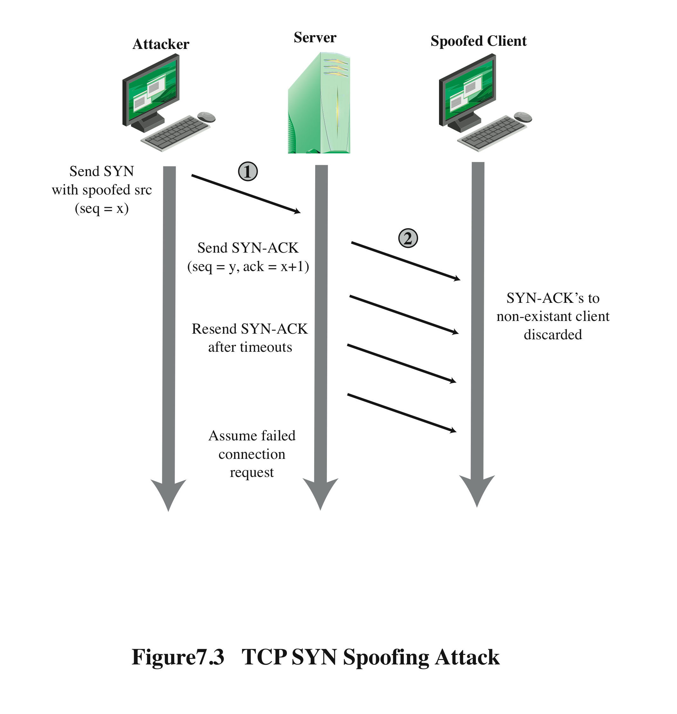
TCP SYN Spoofing Attack
Notes:
A SYN spoofing attack exploits this behavior on the targeted server system.
The attacker generates a number of SYN connection request packets with forged
source addresses. For each of these the server records the details of the TCP connection
request and sends the SYN-ACK packet to the claimed source address,
as shown in Figure 7.3 . If there is a valid system at this address, it will respond
with a RST (reset) packet to cancel this unknown connection request. When the
server receives this packet, it cancels the connection request and removes the saved
information. However, if the source system is too busy, or there is no system at the
forged address, then no reply will return. In these cases the server will resend the
SYN-ACK packet a number of times before finally assuming the connection request
has failed and deleting the information saved concerning it. In this period between
when the original SYN packet is received and when the server assumes the request
has failed, the server is using an entry in its table of known TCP connections. This
table is typically sized on the assumption that most connection requests quickly
succeed and that a reasonable number of requests may be handled simultaneously.
However, in a SYN spoofing attack, the attacker directs a very large number of
forged connection requests at the targeted server. These rapidly fill the table of
known TCP connections on the server. Once this table is full, any future requests,
including legitimate requests from other users, are rejected. The table entries will
time out and be removed, which in normal network usage corrects temporary
overflow problems. However, if the attacker keeps a sufficient volume of forged
requests flowing, this table will be constantly full and the server will be effectively
cut off from the Internet, unable to respond to most legitimate connection requests.
In order to increase the usage of the known TCP connections table, the
attacker ideally wishes to use addresses that will not respond to the SYN-ACK with
a RST. This can be done by overloading the host that owns the chosen spoofed
source address, or by simply using a wide range of random addresses. In this case,
the attacker relies on the fact that there are many unused addresses on the Internet.
Consequently, a reasonable proportion of randomly generated addresses will not
correspond to a real host.
There is a significant difference in the volume of network traffic between a
SYN spoof attack and the basic flooding attack we discussed. The actual volume of
SYN traffic can be comparatively low, nowhere near the maximum capacity of the
link to the server. It simply has to be high enough to keep the known TCP connections
table filled. Unlike the flooding attack, this means the attacker does not need
access to a high-volume network connection. In the network shown in Figure 7.1 ,
the medium-sized organization, or even a broadband home user, could successfully
attack the large company server using a SYN spoofing attack.
A flood of packets from a single server or a SYN spoofing attack originating
on a single system were probably the two most common early forms of DoS attacks.
In the case of a flooding attack this was a significant limitation, and attacks evolved
to use multiple systems to increase their effectiveness. We next examine in more
detail some of the variants of a flooding attack. These can be launched either from a
single or multiple systems, using a range of mechanisms, which we explore.

Slide 10
Flooding Attacks
classified based on network protocol used
intent is to overload the network capacity on some link to a server
virtually any type of network packet can be used
ICMP flood
ping flood using ICMP echo request packets
traditionally network administrators allow such packets into their networks because ping is a useful network diagnostic tool
UDP flood
uses UDP packets directed to some port number on the target system
TCP SYN flood
sends TCP packets to the target system
total volume of packets is the aim of the attack rather than the system code
Notes:
Flooding attacks take a variety of forms, based on which network protocol is being
used to implement the attack. In all cases the intent is generally to overload the
network capacity on some link to a server. The attack may alternatively aim to
overload the server’s ability to handle and respond to this traffic. These attacks flood
the network link to the server with a torrent of malicious packets competing with, and
usually overwhelming, valid traffic flowing to the server. In response to the congestion
this causes in some routers on the path to the targeted server, many packets will be
dropped. Valid traffic has a low probability of surviving discard caused by this flood
and hence of accessing the server. This results in the server’s ability to respond to
network connection requests being either severely degraded or failing entirely.
Virtually any type of network packet can be used in a flooding attack. It simply
needs to be of a type that is permitted to flow over the links toward the targeted system,
so that it can consume all available capacity on some link to the target server. Indeed,
the larger the packet, the more effective is the attack. Common flooding attacks use
any of the ICMP, UDP, or TCP SYN packet types. It is even possible to flood with
some other IP packet type. However, as these are less common and their usage more
targeted, it is easier to filter for them and hence hinder or block such attacks.
The ping flood using ICMP echo request packets we discuss in Section 7.1 is a classic
example of an ICMP flooding attack. This type of ICMP packet was chosen since
traditionally network administrators allowed such packets into their networks, as
ping is a useful network diagnostic tool. More recently, many organizations have
restricted the ability of these packets to pass through their firewalls. In response,
attackers have started using other ICMP packet types. Since some of these should
be handled to allow the correct operation of TCP/IP, they are much more likely to
be allowed through an organization’s firewall. Filtering some of these critical ICMP
packet types would degrade or break normal TCP/IP network behavior. ICMP
destination unreachable and time exceeded packets are examples of such critical
packet types.
An attacker can generate large volumes of one of these packet types. Because
these packets include part of some notional erroneous packet that supposedly
caused the error being reported, they can be made comparatively large, increasing
their effectiveness in flooding the link.
An alternative to using ICMP packets is to use UDP packets directed to some port
number, and hence potential service, on the target system. A common choice was a
packet directed at the diagnostic echo service, commonly enabled on many server
systems by default. If the server had this service running, it would respond with a
UDP packet back to the claimed source containing the original packet data contents.
If the service is not running, then the packet is discarded, and possibly an
ICMP destination unreachable packet is returned to the sender. By then the attack
has already achieved its goal of occupying capacity on the link to the server. Just
about any UDP port number can be used for this end. Any packets generated in
response only serve to increase the load on the server and its network links.
Spoofed source addresses are normally used if the attack is generated using
a single source system, for the same reasons as with ICMP attacks. If multiple systems
are used for the attack, often the real addresses of the compromised, zombie,
systems are used. When multiple systems are used, the consequences of both the
reflected flow of packets and the ability to identify the attacker are reduced.
Another alternative is to send TCP packets to the target system. Most likely these
would be normal TCP connection requests, with either real or spoofed source
addresses. They would have an effect similar to the SYN spoofing attack we’ve
described. In this case, though, it is the total volume of packets that is the aim of the
attack rather than the system code. This is the difference between a SYN spoofing
attack and a SYN flooding attack.
This attack could also use TCP data packets, which would be rejected by the
server as not belonging to any known connection. But again, by this time the attack
has already succeeded in flooding the links to the server.
All of these flooding attack variants are limited in the total volume of traffic
that can be generated if just a single system is used to launch the attack. The use
of a single system also means the attacker is easier to trace. For these reasons, a
variety of more sophisticated attacks, involving multiple attacking systems, have
been developed. By using multiple systems, the attacker can significantly scale up
the volume of traffic that can be generated. Each of these systems need not be particularly
powerful or on a high-capacity link. But what they don’t have individually,
they more than compensate for in large numbers. Also, by directing the attack
through intermediaries, the attacker is further distanced from the target and significantly
harder to locate and identify. Indirect attack types that utilize multiple
systems include
• Distributed denial-of-service attacks
• Reflector attacks
• Amplifier attacks
We consider each of these in turn.

Slide 11
Distributed Denial of Service DDoS Attacks
use of multiple systems to generate attacks
attacker uses a flaw in operating system or in a common application to gain access and installs their program on it (zombie)
large collections of such systems under the control of one attacker’s control can be created, forming a botnet
Notes:
Recognizing the limitations of flooding attacks generated by a single system, one
of the earlier significant developments in DoS attack tools was the use of multiple
systems to generate attacks. These systems were typically compromised user workstations
or PCs. The attacker used some well-known flaw in the operating system or
in some common application to gain access to these systems and to install his or her
own programs on it. Such systems are known as zombies. Once suitable backdoor
programs were installed on these systems, they were entirely under the attacker’s
control. Large collections of such systems under the control of one attacker can be
created, collectively forming a botnet, as we discuss in Chapter 6 . Such networks of
compromised systems are a favorite tool of attacker, and can be used for a variety
of purposes, including distributed denial-of-service (DDoS) attacks. In the example
network shown in Figure 7.1 , some of the broadband user systems may be compromised
and used as zombies to attack any of the company or other links shown.
Many other DDoS tools have been developed since. Instead of using dedicated
handler programs, many now use an IRC or similar instant messaging server
program to manage communications with the agents. Many of these more recent
tools also use cryptographic mechanisms to authenticate the agents to the handlers,
in order to hinder analysis of command traffic.
The best defense against being an unwitting participant in a DDoS attack is to
prevent your systems from being compromised. This requires good system security
practices and keeping the operating systems and applications on such systems current
and patched.
For the target of a DDoS attack, the response is the same as for any flooding
attack, but with greater volume and complexity. We discuss appropriate defenses
and responses in Sections 7.5 and 7.6 .

Slide 12
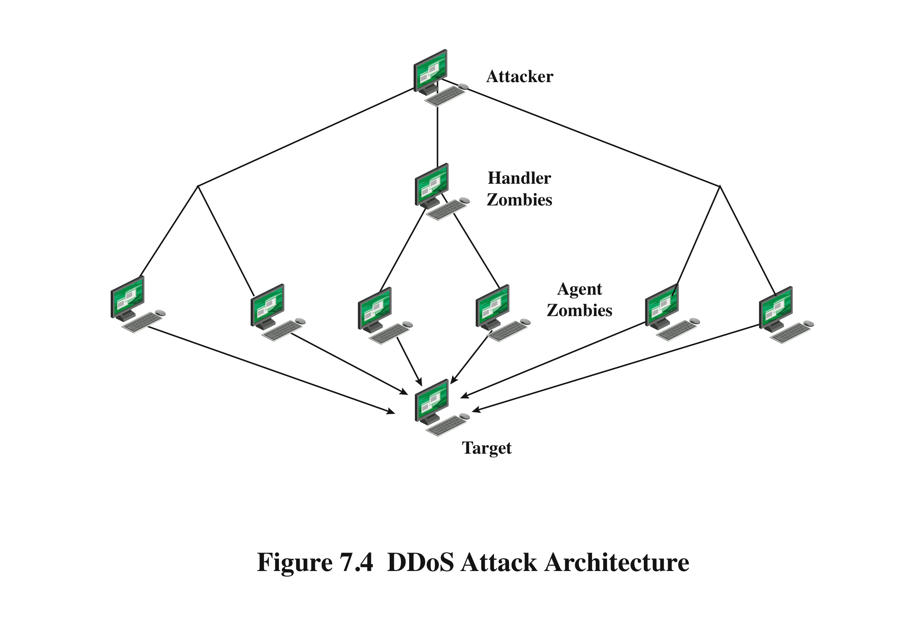
DDoS Attack Architecture
Notes:
While the attacker could command each zombie individually, more generally
a control hierarchy is used. A small number of systems act as handlers controlling a
much larger number of agent systems, as shown in Figure 7.4 . There are a number of
advantages to this arrangement. The attacker can send a single command to a handler,
which then automatically forwards it to all the agents under its control. Automated
infection tools can also be used to scan for and compromise suitable zombie systems,
as we discuss in Chapter 6 . Once the agent software is uploaded to a newly compromised
system, it can contact one or more handlers to automatically notify them of its
availability. By this means, the attacker can automatically grow suitable botnets.

Slide 13
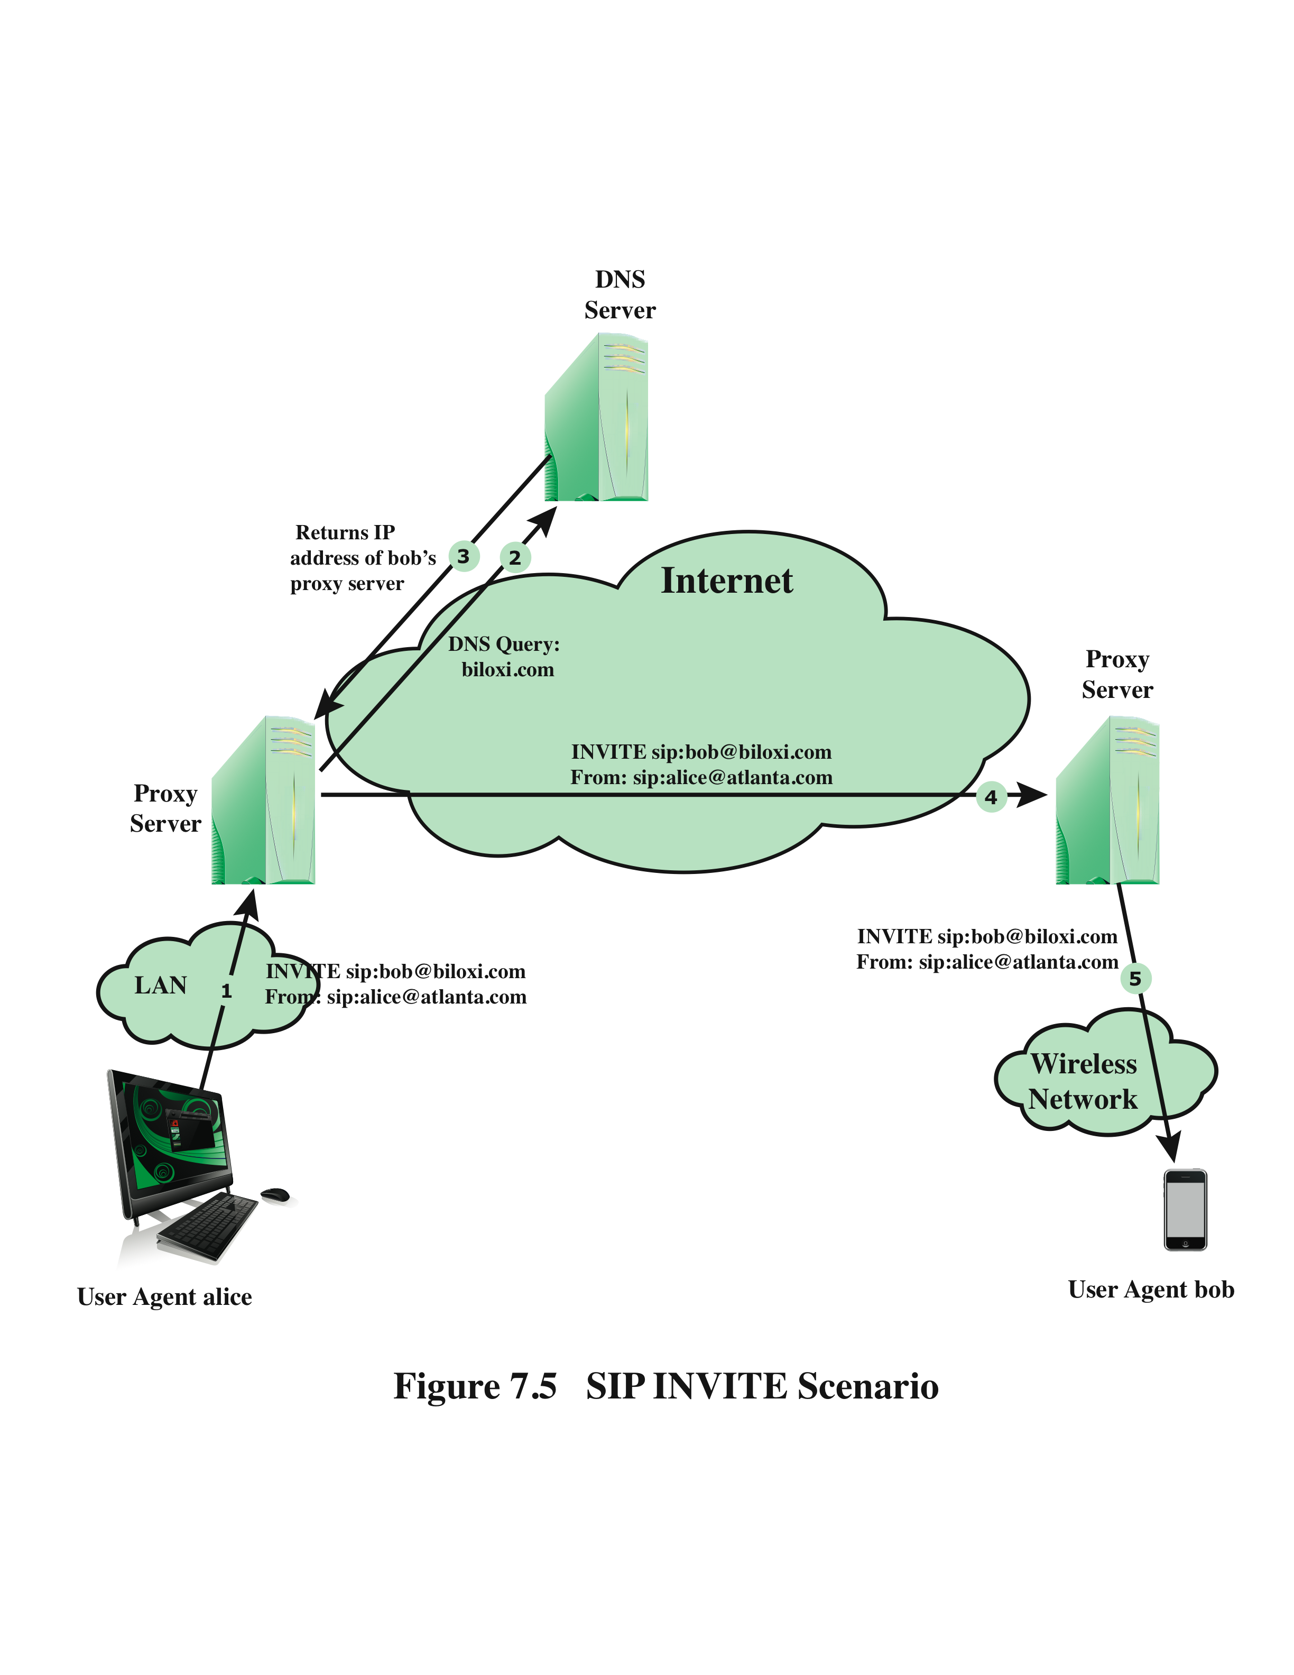
Session Initiation Protocol (SIP) Flood
standard protocol for VoIP telephony
text-based protocol with a syntax similar to that of HTTP
two types of SIP messages: requests and responses
Notes:
Voice over IP (VoIP) telephony is now widely deployed over the Internet. The standard
protocol used for call setup in VoIP is the Session Initiation Protocol (SIP).
SIP is a text-based protocol with a syntax similar to that of HTTP. There are two
different types of SIP messages: requests and responses. Figure 7.5 is a simplified
illustration of the operation of the SIP INVITE message, used to establish a media
session between user agents. In this case, Alice’s user agent runs on a computer, and
Bob’s user agent runs on a cell phone. Alice’s user agent is configured to communicate
with a proxy server (the outbound server) in its domain and begins by sending
an INVITE SIP request to the proxy server that indicates its desire to invite Bob’s
user agent into a session. The proxy server uses a DNS server to get the address
of Bob’s proxy server, and then forwards the INVITE request to that server. The
server then forwards the request to Bob’s user agent, causing Bob’s phone to ring.
A SIP flood attack exploits the fact that a single INVITE request triggers considerable
resource consumption. The attacker can flood a SIP proxy with numerous
INVITE requests with spoofed IP addresses, or alternately a DDoS attack using a
botnet to generate numerous INVITE request. This attack puts a load on the SIP

Slide 14
Hypertext Transfer Protocol (HTTP) Based Attacks
HTTP flood
Slowloris
attack that bombards Web servers with HTTP requests
consumes considerable resources
spidering
bots starting from a given HTTP link and following all links on the provided Web site in a recursive way
attempts to monopolize by sending HTTP requests that never complete
eventually consumes Web server’s connection capacity
utilizes legitimate HTTP traffic
existing intrusion detection and prevention solutions that rely on signatures to detect attacks will generally not recognize Slowloris
Notes:
An intriguing and unusual form of HTTP-based attack is Slowloris
[GIOB09]. Slowloris exploits the common server technique of using multiple
threads to support multiple requests to the same server application. It attempts
to monopolize all of the available request handling threads on the Web server
by sending HTTP requests that never complete. Since each request consumes a
thread, the Slowloris attack eventually consumes all of the Web server’s connection
capacity, effectively denying access to legitimate users.
The HTTP protocol specification (RFC2616) states that a blank line must be
used to indicate the end of the request headers and the beginning of the payload,
if any. Once the entire request is received, the Web server may then respond. The
Slowloris attack operates by establishing multiple connections to the Web server.
On each connection, it sends an incomplete request that does not include the terminating
newline sequence. The attacker sends additional header lines periodically to
keep the connection alive, but never sends the terminating newline sequence. The
Web server keeps the connection open, expecting more information to complete
the request. As the attack continues, the volume of long-standing Slowloris connections
increases, eventually consuming all available Web server connections, thus
rendering the Web server unavailable to respond to legitimate requests.
Slowloris is different from typical denials of service in that Slowloris traffic
utilizes legitimate HTTP traffic, and does not rely on using special “bad” HTTP
requests that exploit bugs in specific HTTP servers. Because of this, existing intrusion
detection and intrusion prevention solutions that rely on signatures to detect
attacks will generally not recognize Slowloris. This means that Slowloris is capable
of being effective even when standard enterprise-grade intrusion detection and
intrusion prevention systems are in place.
There are a number of countermeasures that can be taken against Slowloris
type attacks, including limiting the rate of incoming connections from a particular
host; varying the timeout on connections as a function of the number of connections;
and delayed binding. Delayed binding is performed by load balancing software. In
essence, the load balancer performs an HTTP request header completeness check,
which means that the HTTP request will not be sent to the appropriate Web server
until the final two carriage return and line feeds are sent by the HTTP client. This is
the key bit of information. Basically, delayed binding ensures that your Web server
or proxy will never see any of the incomplete requests being sent out by Slowloris.

Slide 15
Reflection Attacks
attacker sends packets to a known service on the intermediary with a spoofed source address of the actual target system
when intermediary responds, the response is sent to the target
“reflects” the attack off the intermediary (reflector)
goal is to generate enough volumes of packets to flood the link to the target system without alerting the intermediary
the basic defense against these attacks is blocking spoofed-source packets
Notes:
In contrast to DDoS attacks, where the intermediaries are compromised systems
running the attacker’s programs, reflector and amplifier attacks use network systems
functioning normally. The attacker sends a network packet with a spoofed source
address to a service running on some network server. The server responds to this
packet, sending it to the spoofed source address that belongs to the actual attack
target. If the attacker sends a number of requests to a number of servers, all with the
same spoofed source address, the resulting flood of responses can overwhelm the
target’s network link. The fact that normal server systems are being used as intermediaries,
and that their handling of the packets is entirely conventional, means
these attacks can be easier to deploy and harder to trace back to the actual attacker.
There are two basic variants of this type of attack: the simple reflection attack and
the amplification attack.
The reflection attack is a direct implementation of this type of attack. The attacker
sends packets to a known service on the intermediary with a spoofed source address
of the actual target system. When the intermediary responds, the response is sent to
the target. Effectively this reflects the attack off the intermediary, which is termed
the reflector, and is why this is called a reflection attack.
Ideally the attacker would like to use a service that created a larger response
packet than the original request. This allows the attacker to convert a lower volume
stream of packets from the originating system into a higher volume of packet data
from the intermediary directed at the target. Common UDP services are often used
for this purpose. Originally the echo service was a favored choice, although it does
not create a larger response packet. However, any generally accessible UDP service
could be used for this type of attack. The chargen, DNS, SNMP, or ISAKMP
services have all been exploited in this manner, in part because they can be made to
generate larger response packets directed at the target.
The intermediary systems are often chosen to be high-capacity network servers
or routers with very good network connections. This means they can generate
high volumes of traffic if necessary, and if not, the attack traffic can be obscured in
the normal high volumes of traffic flowing through them. If the attacker spreads the
attack over a number of intermediaries in a cyclic manner, then the attack traffic
flow may well not be easily distinguished from the other traffic flowing from the
system. This, combined with the use of spoofed source addresses, greatly increases
the difficulty of any attempt to trace the packet flows back to the attacker’s system.
Another variant of reflection attack uses TCP SYN packets and exploits the
normal three-way handshake used to establish a TCP connection. The attacker sends
a number of SYN packets with spoofed source addresses to the chosen intermediaries.
In turn the intermediaries respond with a SYN-ACK packet to the spoofed
source address, which is actually the target system. The attacker uses this attack
with a number of intermediaries. The aim is to generate high enough volumes of
packets to flood the link to the target system. The target system will respond with a
RST packet for any that get through, but by then the attack has already succeeded
in overwhelming the target’s network link.
This attack variant is a flooding attack that differs from the SYN spoofing
attack we discussed earlier in this chapter. The goal is to flood the network link
to the target, not to exhaust its network handling resources. Indeed, the attacker
would usually take care to limit the volume of traffic to any particular intermediary
to ensure that it is not overwhelmed by, or even notices, this traffic. This is both
because its continued correct functioning is an essential component of this attack,
as is limiting the chance of the attacker’s actions being detected. The 2002 attack on
GRC.com was of this form. It used connection requests to the BGP routing service
on core routers as the primary intermediaries. These generated sufficient response
traffic to completely block normal access to GRC.com. However, as GRC.com
discovered, once this traffic was blocked, a range of other services, on other intermediaries,
were also being used. GRC noted in its report on this attack that “you
know you’re in trouble when packet floods are competing to flood you.”
Any generally accessible TCP service can be used in this type of attack. Given
the large number of servers available on the Internet, including many well-known
servers with very high capacity network links, there are many possible intermediaries
that can be used. What makes this attack even more effective is that the
individual TCP connection requests are indistinguishable from normal connection
requests directed to the server. It is only if they are running some form of intrusion
detection system that detects the large numbers of failed connection requests from
one system that this attack might be detected and possibly blocked. If the attacker is
using a number of intermediaries, then it is very likely that even if some detect and
block the attack, many others will not, and the attack will still succeed.

Slide 16
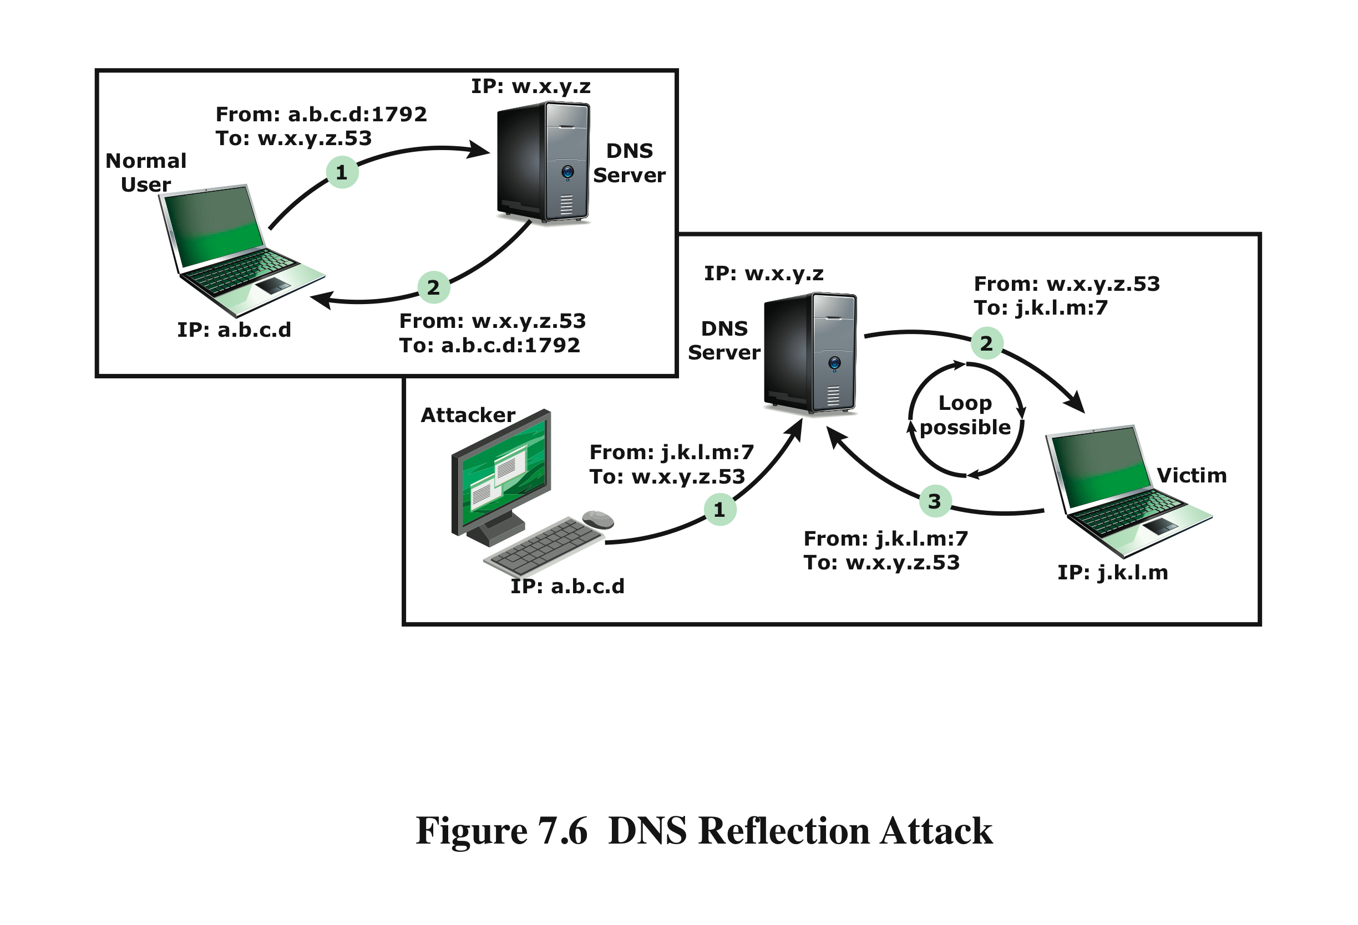
DNS Reflection Attacks
Notes:
A further variation of the reflector attack establishes a self-contained loop
between the intermediary and the target system. Both systems act as reflectors.
Figure 7.6 , based on [SCAR08], shows this type of attack. The upper part of the
figure shows normal Domain Name System operation. The DNS client sends a
query from its UDP port 1792 to the server’s DNS port 53 to obtain the IP address
of a domain name. The DNS server sends a UDP response packet including the
IP address. The lower part of the figure shows a reflection attack using DNS.
The attacker sends a query to the DNS server with a spoofed IP source address
of j.k.l.m; this is the IP address of the target. The attacker uses port 7, which is
usually associated with echo, a reflector service. The DNS server then sends a
response to the victim of the attack, j.k.l.m, addressed to port 7. If the victim is
offering the echo service, it may create a packet that echoes the received data back
to the DNS server. This can cause a loop between the DNS server and the victim if
the DNS server responds to the packets sent by the victim. Most reflector attacks
can be prevented through network-based and host-based firewall rulesets that
reject suspicious combinations of source and destination ports.
While very effective if possible, this type of attack is fairly easy to filter for
because the combinations of service ports used should never occur in normal network
operation.
When implementing any of these reflection attacks, the attacker could use just
one system as the original source of packets. This suffices, particularly if a service is used
that generates larger response packets than those originally sent to the intermediary.
Alternatively, multiple systems might be used to generate higher volumes of traffic
to be reflected and to further obscure the path back to the attacker. Typically a botnet
would be used in this case.
Another characteristic of reflection attacks is the lack of backscatter traffic.
In both direct flooding attacks and SYN spoofing attacks, the use of spoofed
source addresses results in response packets being scattered across the Internet and
thus detectable. This allows security researchers to estimate the volumes of such
attacks. In reflection attacks, the spoofed source address directs all the packets at
the desired target and any responses to the intermediary. There is no generally visible
side effect of these attacks, making them much harder to quantify. Evidence of
them is only available from either the targeted systems and their ISPs or the intermediary
systems. In either case, specific instrumentation and monitoring would be
needed to collect this evidence.
Fundamental to the success of reflection attacks is the ability to create
spoofed-source packets. If filters are in place that block spoofed-source packets,
then these attacks are simply not possible. This is the most basic, fundamental
defense against such attacks. This is not the case with either SYN spoofing or flooding
attacks (distributed or not). They can succeed using real source addresses, with
the consequences already noted.

Slide 17
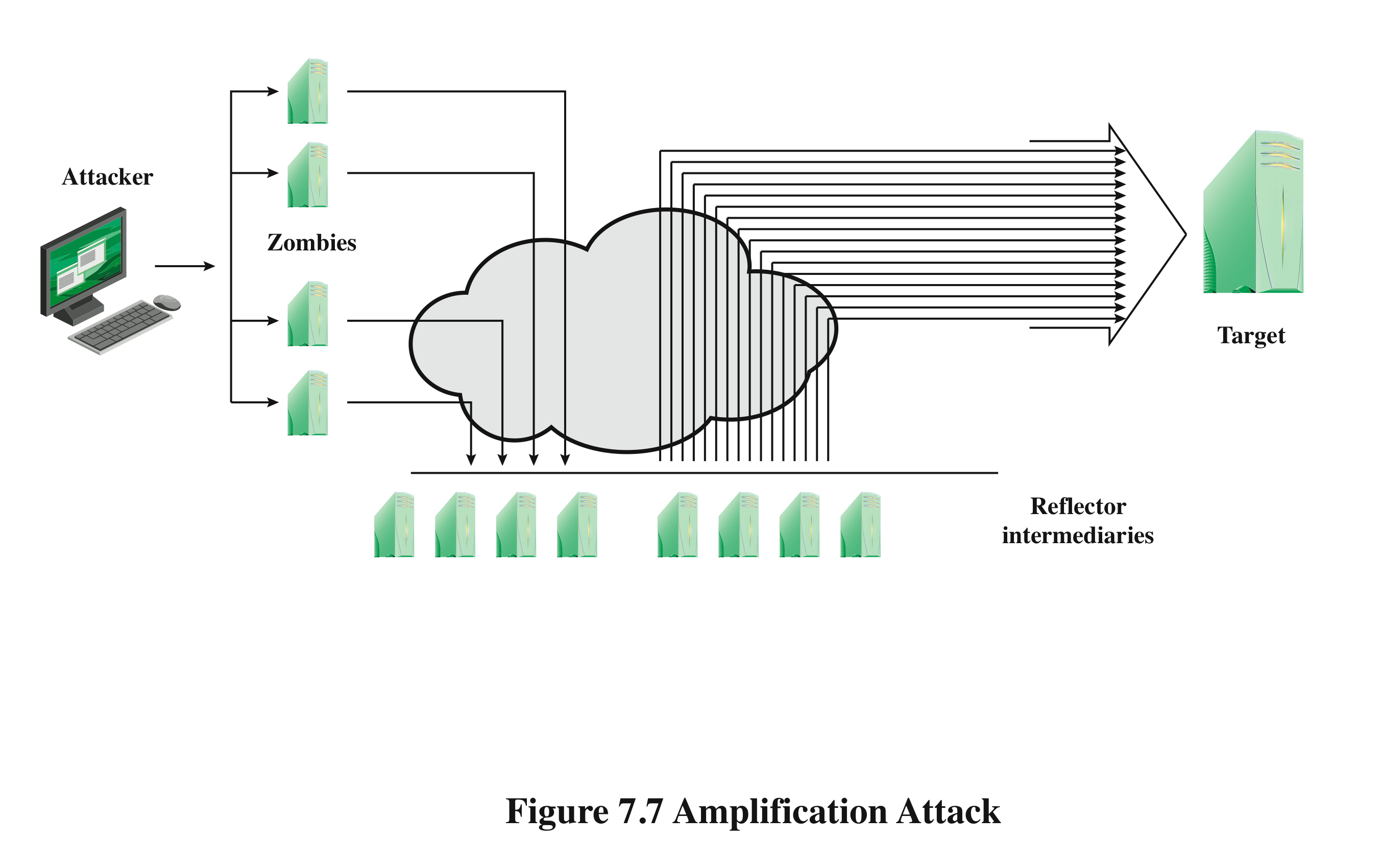
Amplification Attacks
Notes:
Amplification attacks are a variant of reflector attacks and also involve sending a
packet with a spoofed source address for the target system to intermediaries. They
differ in generating multiple response packets for each original packet sent. This can
be achieved by directing the original request to the broadcast address for some network.
As a result, all hosts on that network can potentially respond to the request,
generating a flood of responses as shown in Figure 7.7 . It is only necessary to use
a service handled by large numbers of hosts on the intermediate network. A ping
flood using ICMP echo request packets was a common choice, since this service
is a fundamental component of TCP/IP implementations and was often allowed
into networks. The well-known smurf DoS program used this mechanism and was
widely popular for some time. Another possibility is to use a suitable UDP service,
such as the echo service. The fraggle program implemented this variant. Note that
TCP services cannot be used in this type of attack; because they are connection
oriented, they cannot be directed at a broadcast address. Broadcasts are inherently
connectionless.
The best additional defense against this form of attack is to not allow directed
broadcasts to be routed into a network from outside. Indeed, this is another longstanding
security recommendation, unfortunately about as widely implemented as
that for blocking spoofed source addresses. If these forms of filtering are in place,
these attacks cannot succeed. Another defense is to limit network services like echo
and ping from being accessed from outside an organization. This restricts which
services could be used in these attacks, at a cost in ease of analyzing some legitimate
network problems.
Attackers scan the Internet looking for well-connected networks that do allow
directed broadcasts and that implement suitable services attackers can reflect off.
These lists are traded and used to implement such attacks.

Slide 18
DNS Amplification Attacks
use packets directed at a legitimate DNS server as the intermediary system
attacker creates a series of DNS requests containing the spoofed source address of the target system
exploit DNS behavior to convert a small request to a much larger response (amplification)
target is flooded with responses
basic defense against this attack is to prevent the use of spoofed source addresses
Notes:
In addition to the DNS reflection attack discussed previously, a further variant of an
amplification attack uses packets directed at a legitimate DNS server as the intermediary
system. Attackers gain attack amplification by exploiting the behavior of the
DNS protocol to convert a small request into a much larger response. This contrasts
with the original amplifier attacks, which use responses from multiple systems to a
single request to gain amplification. Using the classic DNS protocol, a 60-byte UDP
request packet can easily result in a 512-byte UDP response, the maximum traditionally
allowed. All that is needed is a name server with DNS records large enough for
this to occur.
These attacks have been seen for several years. More recently, the DNS
protocol has been extended to allow much larger responses of over 4000 bytes to
support extended DNS features such as IPv6, security, and others. By targeting
servers that support the extended DNS protocol, significantly greater amplification
can be achieved than with the classic DNS protocol.
In this attack, a selection of suitable DNS servers with good network connections
are chosen. The attacker creates a series of DNS requests containing
the spoofed source address of the target system. These are directed at a number
of the selected name servers. The servers respond to these requests, sending the
replies to the spoofed source, which appears to them to be the legitimate requesting
system. The target is then flooded with their responses. Because of the amplification
achieved, the attacker need only generate a moderate flow of packets to
cause a larger, amplified flow to flood and overflow the link to the target system.
Intermediate systems will also experience significant loads. By using a number of
high-capacity, well-connected systems, the attacker can ensure that intermediate
systems are not overloaded, allowing the attack to proceed.
A further variant of this attack exploits recursive DNS name servers. This is
a basic feature of the DNS protocol that permits a DNS name server to query a
number of other servers to resolve a query for its clients. The intention was that this
feature is used to support local clients only. However, many DNS systems support
recursion by default for any requests. They are known as open recursive DNS servers.
Attackers may exploit such servers for a number of DNS-based attacks, including
the DNS amplification DoS attack. In this variant, the attacker targets a number
of open recursive DNS servers. The name information being used for the attack
need not reside on these servers, but can be sourced from anywhere on the Internet.
The results are directed at the desired target using spoofed source addresses.
Like all the reflection-based attacks, the basic defense against these is to prevent
the use of spoofed source addresses. Appropriate configuration of DNS servers,
in particular limiting recursive responses to internal client systems only, can
restrict some variants of this attack.

Slide 19
DoS Attack Defenses
four lines of defense against DDoS attacks
attack prevention and preemption
Enforce resource consumption policies and provide backups for systems
attack detection and filtering
Filter out packets likely to be part of attack
attack source traceback and identification
Often doesn’t yield results fast enough to to current attack, but can prevent future ones
attack reaction
after the attack
these attacks cannot be prevented entirely
high traffic volumes may be legitimate
high publicity about a specific site
activity on a very popular site
described as slashdotted, flash crowd, or flash event
Notes:
There are a number of steps that can be taken both to limit the consequences of
being the target of a DoS attack and to limit the chance of your systems being compromised
and then used to launch DoS attacks. It is important to recognize that
these attacks cannot be prevented entirely. In particular, if an attacker can direct a
large enough volume of legitimate traffic to your system, then there is a high chance
this will overwhelm your system’s network connection, and thus limit legitimate
traffic requests from other users. Indeed, this sometimes occurs by accident as a
result of high publicity about a specific site. Classically, a posting to the well-known
Slashdot news aggregation site often results in overload of the referenced server
system. Similarly, when popular sporting events like the Olympics or Soccer World
Cup matches occur, sites reporting on them experience very high traffic levels. This
has led to the terms slashdotted , flash crowd , or flash event being used to describe
such occurrences. There is very little that can be done to prevent this type of either
accidental or deliberate overload without also compromising network performance.
The provision of significant excess network bandwidth and replicated distributed
servers is the usual response, particularly when the overload is anticipated. This is
regularly done for popular sporting sites. However, this response does have a significant
implementation cost.
In general, there are four lines of defense against DDoS attacks [PENG07,
CHAN02]:
• Attack prevention and preemption (before the attack): These mechanisms
enable the victim to endure attack attempts without denying service to legitimate
clients. Techniques include enforcing policies for resource consumption
and providing backup resources available on demand. In addition, prevention
mechanisms modify systems and protocols on the Internet to reduce the
possibility of DDoS attacks.
• Attack detection and filtering (during the attack): These mechanisms attempt
to detect the attack as it begins and respond immediately. This minimizes the
impact of the attack on the target. Detection involves looking for suspicious
patterns of behavior. Response involves filtering out packets likely to be part
of the attack.
• Attack source traceback and identification (during and after the attack): This
is an attempt to identify the source of the attack as a first step in preventing
future attacks. However, this method typically does not yield results fast
enough, if at all, to mitigate an ongoing attack.
• Attack reaction (after the attack): This is an attempt to eliminate or curtail the
effects of an attack.
We discuss the first of these lines of defense in this section and consider the
remaining three in Section 7.7 .

Slide 20
DoS Attack Prevention
block spoofed source addresses
on routers as close to source as possible
filters may be used to ensure path back to the claimed source address is the one being used by the current packet
filters must be applied to traffic before it leaves the ISP’s network or at the point of entry to their network
use modified TCP connection handling code
cryptographically encode critical information in a cookie that is sent as the server’s initial sequence number
legitimate client responds with an ACK packet containing the incremented sequence number cookie
drop an entry for an incomplete connection from the TCP connections table when it overflows
Notes:
A critical component of many DoS attacks is the use of spoofed source
addresses. These either obscure the originating system of direct and distributed DoS
attacks or are used to direct reflected or amplified traffic to the target system. Hence
one of the fundamental, and longest standing, recommendations for defense against
these attacks is to limit the ability of systems to send packets with spoofed source
addresses. RFC 2827, Network Ingress Filtering: Defeating Denial-of-service attacks
which employ IP Source Address Spoofing , directly makes this recommendation, as
do SANS, CERT, and many other organizations concerned with network security.
This filtering needs to be done as close to the source as possible, by routers
or gateways knowing the valid address ranges of incoming packets. Typically this is
the ISP providing the network connection for an organization or home user. An ISP
knows which addresses are allocated to all its customers and hence is best placed to
ensure that valid source addresses are used in all packets from its customers. This
type of filtering can be implemented using explicit access control rules in a router to
ensure that the source address on any customer packet is one allocated to the ISP.
Alternatively, filters may be used to ensure that the path back to the claimed source
address is the one being used by the current packet. For example, this may be done
on Cisco routers using the “ip verify unicast reverse-path” command. This latter
approach may not be possible for some ISPs that use a complex, redundant routing
infrastructure. Implementing some form of such a filter ensures that the ISP’s
customers cannot be the source of spoofed packets. Regrettably, despite this being
a well-known recommendation, many ISPs still do not perform this type of filtering.
In particular, those with large numbers of broadband-connected home users are of
major concern. Such systems are often targeted for attack as they are often less well
secured than corporate systems. Once compromised, they are then used as intermediaries
in other attacks, such as DoS attacks. By not implementing antispoofing
filters, ISPs are clearly contributing to this problem. One argument often advanced
for not doing so is the performance impact on their routers. While filtering does
incur a small penalty, so does having to process volumes of attack traffic. Given
the high prevalence of DoS attacks, there is simply no justification for any ISP or
organization not to implement such a basic security recommendation.
Any defenses against flooding attacks need to be located back in the Internet
cloud, not at a target organization’s boundary router, since this is usually located
after the resource being attacked. The filters must be applied to traffic before it
leaves the ISP’s network, or even at the point of entry to their network. While it is
not possible, in general, to identify packets with spoofed source addresses, the use
of a reverse path filter can help identify some such packets where the path from
the ISP to the spoofed address differs to that used by the packet to reach the ISP.
Also, attacks using particular packet types, such as ICMP floods or UDP floods to
diagnostic services, can be throttled by imposing limits on the rate at which these
packets will be accepted. In normal network operation, these should comprise a
relatively small fraction of the overall volume of network traffic. Many routers,
particularly the high-end routers used by ISPs, have the ability to limit packet rates.
Setting appropriate rate limits on these types of packets can help mitigate the effect
of packet floods using them, allowing other types of traffic to flow to the targeted
organization even should an attack occur.
It is possible to specifically defend against the SYN spoofing attack by using a
modified version of the TCP connection handling code. Instead of saving the connection
details on the server, critical information about the requested connection
is cryptographically encoded in a cookie that is sent as the server’s initial sequence
number. This is sent in the SYN-ACK packet from the server back to the client.
When a legitimate client responds with an ACK packet containing the incremented
sequence number cookie, the server is then able to reconstruct the information
about the connection that it normally would have saved in the known TCP connections
table. Typically this technique is only used when the table overflows. It
has the advantage of not consuming any memory resources on the server until the
three-way TCP connection handshake is completed. The server then has greater
confidence that the source address does indeed correspond with a real client that is
interacting with the server.
There are some disadvantages of this technique. It does take computation
resources on the server to calculate the cookie. It also blocks the use of certain TCP
extensions, such as large windows. The request for such an extension is normally
saved by the server, along with other details of the requested connection. However,
this connection information cannot be encoded in the cookie as there is not enough
room to do so. Since the alternative is for the server to reject the connection entirely
as it has no resources left to manage the request, this is still an improvement in
the system’s ability to handle high connection-request loads. This approach was
independently invented by a number of people. The best-known variant is SYN
Cookies, whose principal originator is Daniel Bernstein. It is available in recent
FreeBSD and Linux systems, though it is not enabled by default. A variant of this
technique is also included in Windows 2000, XP, and later. This is used whenever
their TCP connections table overflows.
Alternatively, the system’s TCP/IP network code can be modified to selectively
drop an entry for an incomplete connection from the TCP connections table
when it overflows, allowing a new connection attempt to proceed. This is known as
selective drop or random drop . On the assumption that the majority of the entries in
an overflowing table result from the attack, it is more likely that the dropped entry
will correspond to an attack packet. Hence its removal will have no consequence. If
not, then a legitimate connection attempt will fail, and will have to retry. However,
this approach does give new connection attempts a chance of succeeding rather than
being dropped immediately when the table overflows.
Another defense against SYN spoofing attacks includes modifying parameters
used in a system’s TCP/IP network code. These include the size of the TCP connections
table and the timeout period used to remove entries from this table when
no response is received. These can be combined with suitable rate limits on the
organization’s network link to manage the maximum allowable rate of connection
requests. None of these changes can prevent these attacks, though they do make the
attacker’s task harder.

Slide 21
DoS Attack Prevention
block IP directed broadcasts
block suspicious services and combinations
manage application attacks with a form of graphical puzzle (captcha) to distinguish legitimate human requests
good general system security practices
use mirrored and replicated servers when high-performance and reliability is required
Notes:
The best defense against broadcast amplification attacks is to block the use of
IP-directed broadcasts. This can be done either by the ISP or by any organization
whose systems could be used as an intermediary. As we noted earlier in this chapter,
this and antispoofing filters are long-standing security recommendations that
all organizations should implement. More generally, limiting or blocking traffic to
suspicious services, or combinations of source and destination ports, can restrict the
types of reflection attacks that can be used against an organization.
Defending against attacks on application resources generally requires
modification to the applications targeted, such as Web servers. Defenses may
involve attempts to identify legitimate, generally human initiated, interactions from
automated DoS attacks. These often take the form of a graphical puzzle, a captcha,
which is easy for most humans to solve but difficult to automate. This approach
is used by many of the large portal sites like Hotmail and Yahoo. Alternatively,
applications may limit the rate of some types of interactions in order to continue to
provide some form of service. Some of these alternatives are explored in [KAND05].
Beyond these direct defenses against DoS attack mechanisms, overall good
system security practices should be maintained. The aim is to ensure that your
systems are not compromised and used as zombie systems. Suitable configuration
and monitoring of high performance, well-connected servers is also needed
to help ensure that they don’t contribute to the problem as potential intermediary
servers.
Lastly, if an organization is dependent on network services, it should consider
mirroring and replicating these servers over multiple sites with multiple network
connections. This is good general practice for high-performance servers, and
provides greater levels of reliability and fault tolerance in general and not just a
response to these types of attack.

Slide 22
Responding to DoS Attacks
Good Incident Response Plan
details on how to contact technical personal for ISP
needed to impose traffic filtering upstream
details of how to respond to the attack
antispoofing, directed broadcast, and rate limiting filters should have been implemented
ideally have network monitors and IDS to detect and notify abnormal traffic patterns
Notes:
To respond successfully to a DoS attack, a good incident response plan is needed.
This must include details of how to contact technical personal for your Internet
service provider(s). This contact must be possible using nonnetworked means, since
when under attack your network connection may well not be usable. DoS attacks,
particularly flooding attacks, can only be filtered upstream of your network connection.
The plan should also contain details of how to respond to the attack. The division
of responsibilities between organizational personnel and the ISP will depend
on the resources available and technical capabilities of the organization.
Within an organization you should have implemented the standard antispoofing,
directed broadcast, and rate limiting filters we discuss earlier in this chapter.
Ideally, you should also have some form of automated network monitoring and
intrusion detection system running so personnel will be notified should abnormal
traffic be detected. We discuss such systems in Chapter 8 . Research continues as
to how best identify abnormal traffic. It may be on the basis of changes in patterns
of flow information, source addresses, or other traffic characteristics, as [CARL06]
discuss. It is important that an organization knows its normal traffic patterns so it
has a baseline with which to compare abnormal traffic flows. Without such systems
and knowledge, the earliest indication is likely to be a report from users inside or
outside the organization that its network connection has failed. Identifying the reason
for this failure, whether attack, misconfiguration, or hardware or software failure,
can take valuable additional time to identify.

Slide 23
Responding to DoS Attacks
identify type of attack
capture and analyze packets
design filters to block attack traffic upstream
or identify and correct system/application bug
have ISP trace packet flow back to source
may be difficult and time consuming
necessary if planning legal action
implement contingency plan
switch to alternate backup servers
commission new servers at a new site with new addresses
update incident response plan
analyze the attack and the response for future handling
Notes:
When a DoS attack is detected, the first step is to identify the type of attack
and hence the best approach to defend against it. Typically this involves capturing
packets flowing into the organization and analyzing them, looking for common
attack packet types. This may be done by organizational personnel using suitable
network analysis tools. If the organization lacks the resources and skill to
do this, it will need to have its ISP perform this capture and analysis. From this
analysis the type of attack is identified, and suitable filters are designed to block
the flow of attack packets. These have to be installed by the ISP on its routers. If
the attack targets a bug on a system or application, rather than high traffic volumes,
then this must be identified and steps taken to correct it and prevent future
attacks.
The organization may also wish to ask its ISP to trace the flow of packets back
in an attempt to identify their source. However, if spoofed source addresses are
used, this can be difficult and time-consuming. Whether this is attempted may well
depend on whether the organization intends to report the attack to the relevant law
enforcement agencies. In such a case, additional evidence must be collected and
actions documented to support any subsequent legal action.
In the case of an extended, concerted, flooding attack from a large number of
distributed or reflected systems, it may not be possible to successfully filter enough
of the attack packets to restore network connectivity. In such cases, the organization
needs a contingency strategy either to switch to alternate backup servers or to rapidly
commission new servers at a new site with new addresses, in order to restore
service. Without forward planning to achieve this, the consequence of such an attack
will be extended loss of network connectivity. If the organization depends on this
connection for its function, the consequences on it may be significant.
Following the immediate response to this specific type of attack, the organization’s
incident response policy may specify further steps that are taken to respond
to contingencies like this. This should certainly include analyzing the attack and
response in order to gain benefit from the experience and to improve future handling.
Ideally the organization’s security can be improved as a result. We discuss all
these aspects of incident response further in Chapter 17 .

